Slide 1
Building new boxes

Slide 2

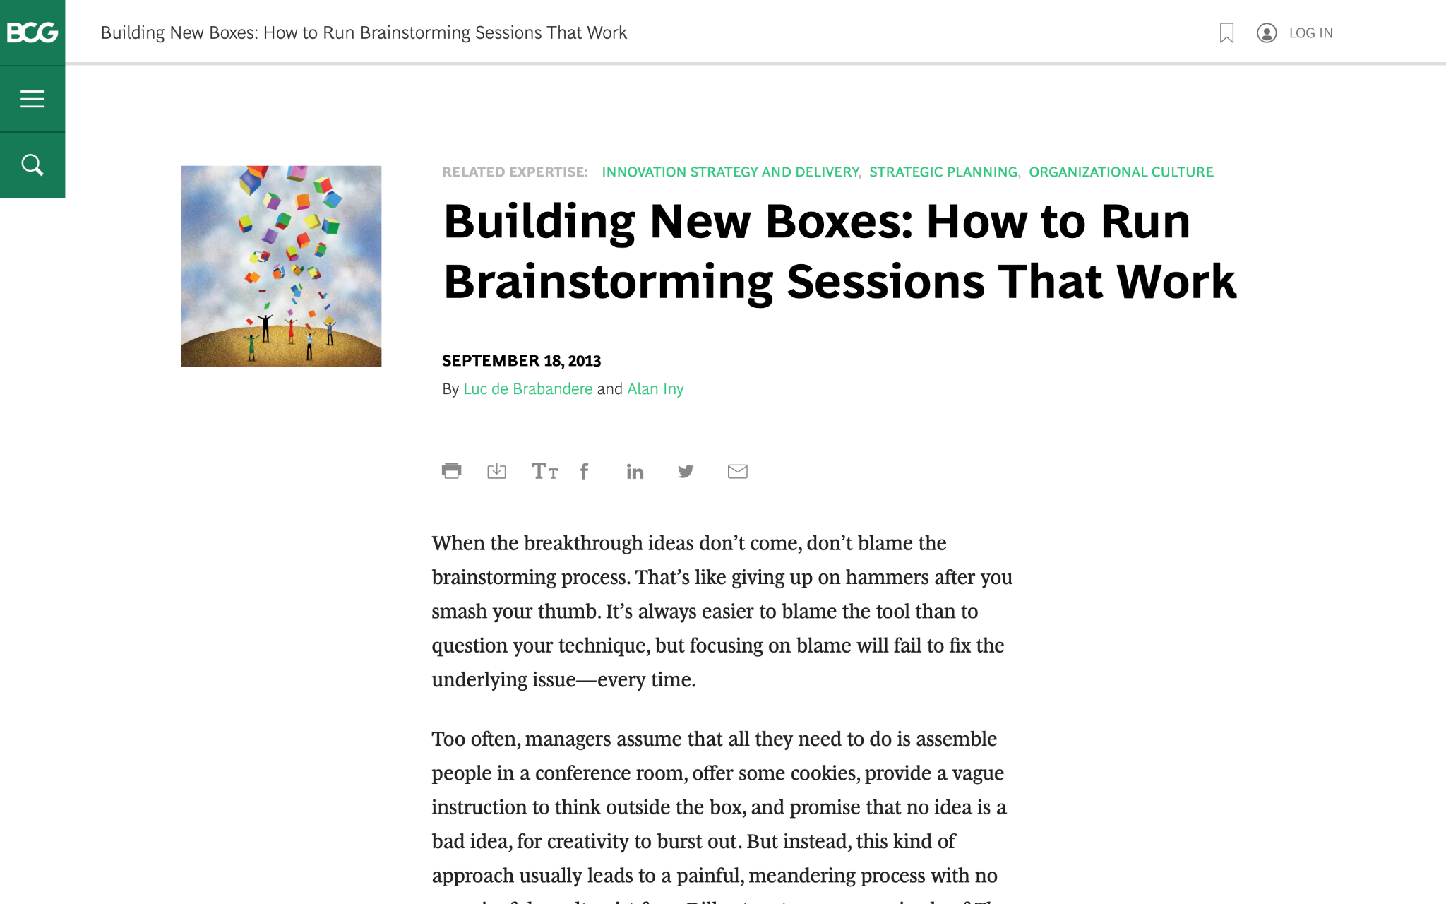
We are going to discuss effective brainstorming. Start by reviewing this article on the BCG website:
Building New Boxes: How to Run Brainstorming Sessions That Work

Slide 3

The article offers five suggestions to achieve real, valuable insights from brainstorming
We will focus on three of these in today’s task (as well as the brainstorming itself), highlighted in green
1.
Frame the question effectively
2.
Create creativity conditions
3.
Reveal and doubt your boxes
4.
Bring new boxes
5.
Follow up
Brainstorm

Slide 4

Your task
BCG has been brought in to help ClothingCo, a luxury clothing brand, grow their top line (i.e., increase revenue) after a period of declining sales.
The client is gearing up for the winter season. Imagine that you are a strategy consultant working on the project.
You will enter your responses in the green boxes throughout the remaining slides.

Slide 5
Frame the question effectively
Question to be reframed
How could we sell more outerwear this winter season?
–
Revised, effective questions:
What if we start a winter collection
How could we look more appealing to youths and fashionistas
How can we keep our customer warmer this season
How could we improve our brand exposure
–
Remember: A good question for brainstorming will be narrow and concrete, so that people feel they know how to begin answering it.
“If I were given one hour to save the planet, I would spend fifty-nine minutes defining the problem and one minute resolving it.”
– Albert Einstein

Slide 6
Reveal and doubt your boxes
In this fictional scenario, make assumptions that seem reasonable
–
What boxes currently exist that are still relevant?
We are a clothing brand
We produce quality product
–
What boxes currently exist that need to be doubted?
Brand exposure through print materials
Customers will definitely buy cloth to cover themselves, why worry
There are bad sales seasons
The first step in the creative process entails identifying and doubting one’s current boxes and determining which ones require re-evaluation or replacement.
Make a short list of the shared beliefs and assumptions that likely prevail in ClothingCo. Determine which are still relevant and which need to be redefined.

Slide 7
Bring new boxes
New box #1
We should leverage digital marketing
How could we rank on various search engines
What if we partner with influencers
What type of blog post would help drive sales
New box #2
Starting a winter collection
What way could we capture all age grades in the collection
What about a fashion show
How could we come to the mind of all potential individuals who thing about the winter season
Prepare for brainstorming by creating new boxes to bring to the session; new boxes will nurture ideation and can dramatically increase the odds of a useful result.
Remember: Defining new boxes requires a mixture of analysis and art. Boxes need to be grounded in fact. Different sectors will call for different inputs.

Slide 8
Brainstorm
Choose one of the effective questions you created on slide 5, and a new box from slide 7, and brainstorm potential ideas to address the question
Question | How could we improve our brand exposure
New box | Leveraging digital marketing
We could sponsor influencers
What if we hold a virtual fashion show
We should start a winter collection
How could we rank high on search engines
We could start a newsletter and discount for subscriber
Sponsor fashion shows and programs
We could create more blog post
Revaluate our social media presence
Revisit or mission and vision

